Slide 1
Indian Auto Component Industry:
Issues of
Strategic Technology Management (STM)

Slide 2
Auto sector in India: facts
Indian Auto industry 6th largest in the world
India overtook Brazil to become the sixth largest passenger vehicle producer in the world (beating such old and new auto makers as Belgium, United Kingdom, Italy, Canada, Mexico, Russia, Spain, France, Brazil).
The industry produced 1,861,849 vehicles in March 2014 (10% more) as against 1,687,243 in 2013 and 1,845,868 in March 2012, (declined by (-) 8.70 percent).

Slide 3
Auto sector in India: facts
Auto industry a leading growth driver (10% of GDP)
The industry accounts for 22 per cent of the country's manufacturing gross domestic product (GDP).
average annual production of 17.5 million vehicles, of which 2.3 million are exported
expertise in the manufacturing of low-cost, fuel-efficient cars
exports are expected to cross $12 billion by 2014
Exports to UK, Italy, Germany, Netherlands and South Africa
FDI inflows during 2000 - 2014 was recorded at US$ 9,885.21 million
Contribution to the GDP is expected to double, reaching a turnover of US$ 145 billion in 2016 and additional employment to 25 million by 2016

Slide 4
India’s Auto Component industry:
Strategic Technology Management (STM) Issues!
Has strong linkages with the capital equipment and the services industry
Auto component industry has transformed itself from a traditional job fulfiller role to a partnership role.
Changing customer preferences, regulations, concern for safety and environment have impacted the product and process technology.
In line with the changes happening in the global automobile and auto component industry, the industry in India has also gone in for Technological Alliances (TA)/Joint ventures (JV) with global auto component manufacturers.
To remain competitive in the global automotive industry, the auto industry in India needs to align its business strategy and technology development.

Slide 5
Auto Component industry: Issues!
produces a comprehensive range of components which include engine parts, drive transmission and steering parts, suspension and braking parts, electrical parts, equipment & other parts.
there are over 550 key players in the auto component sector with a total turnover of US$ 15 billion in 2006–07
In 2011, there were 3,695 factories producing automotive parts in all of India.
The average firm made US$6 million in annual revenue with profits close to US$400 thousand.
moving towards being global suppliers (80% export to global OEMs)
exports grew by 4.4 per cent to touch $9.69 billion in 2013.
Despite a decline in import by five per cent to $12.70 billion last year, the country remained a net importer of components

Slide 6
Issues!
Major challenges are greater competition in domestic as well as export markets, integrating into the global supply chain, Quality level, Low over all technology level: Product design/ Manufacturing / Other technologies in the value chain, WTO and FTA, etc.
Cheap labour, favourable exchange rates and concessional duty structure is becoming inadequate and therefore, not sustainable
Technology development is key for growth
Technology acquisition through collaborations and alliances/ joint ventures has been preferred routes.

Slide 7
Issues!
The key question is how quickly the industry is able adapt to the challenges of the fast changing environment and
how well the industry is able to integrate the technology management with the business strategies of the firms

Slide 8

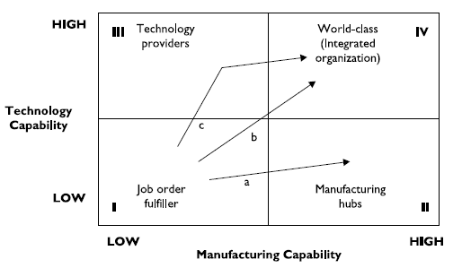
Technology Capability to
Manufacturing Capability matrix

Slide 9
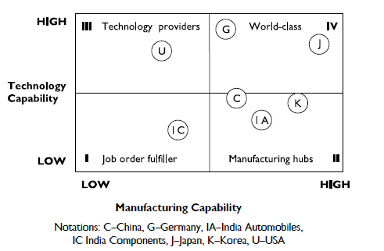
Mapping of Countries on Technology Capability ∼ Manufacturing Capability Matrix

Slide 10
Strategic Technology Management: Key Tasks
the success of high-technology firms in emerging industries, the surge of Japanese competition, recognition of the competitive significance of manufacturing raised interest in TM
key tasks includes: internal and external technology sourcing, deploying technology in product and process development, and using technology in technical support activities.
In turn, performing these activities provides change in the firm’s technical competencies and capabilities.

Slide 11
Gap Identified
There is improvements in manufacturing capability and quality over the years (largest number of Deming Award winners outside Japan etc.)
However, the focus on technology capability development, which is important and of higher level is lacking,
This is the motivation for developing a framework for STM in automotive industry in India

Slide 12
Identification of Factors for STM
Extensive study of literature was carried out and expert opinion was taken to identify the various factors for developing the conceptual framework. Experts from industry and academia were consulted and their views were assimilated for this purpose.
The objective of the Program is Strategic Technology Management for ‘Business Performance’.
‘Business Performance’ is a result of ‘Technology Performance’ and ‘Other Factors’.
‘Technology Strategy’ is strategy to spearhead the technology development activities through ‘In-house development’, ‘TA’ or ‘JV’.
‘Technology capability’ takes place by carrying out technology development, as per the technology strategy.
‘In-house capability’, ‘Technical Agreement’ and ‘Joint Ventures’ are various means of developing technological capability.
For driving the technology strategy, ‘Strategic Business objective’ (based on Top Management leadership and vision) needs to be clearly defined.
‘Government policy and regulations’ provides reasons for firms to enhance their technological capability and thus influence the technology strategy.
‘Other factors’: Factors other than technology (e.g. competition, marketing, customer relationship etc.), that affect business performance—however, not included in the scope of this research work.

Slide 13
STM factors identified
1. Business Performance
2. Strategic Business Objective
3. Technology Performance
4. Technology Strategy
5. Technology Capability
6. In-house Development
7. Technical Agreement (TA)
8. Joint Ventures
9. Government Policy and Regulations
10. Other factors

Slide 14
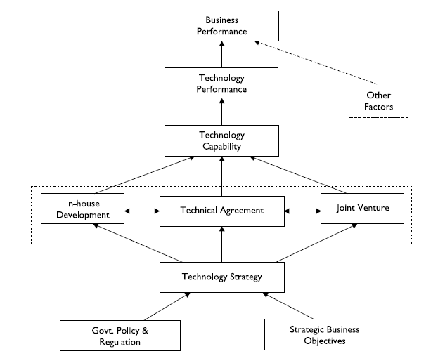
Conceptual Framework for
Strategic Technology Management
The framework identifies ‘Strategic Business Objective’ and ‘Government Policy & Regulations’ as the main driver of ‘Technology Strategy’.
It also identifies ‘In house development’ as one of the routes for developing ‘Technology Capability’, beside the TA and JV routes.
The other key point to be noted is that ‘Technology Performance’ being at a distinct level from ‘Technology Capability’.
This could be explained by the fact that in the context of automotive industry, there is long gestation period involved for translating capability into performance.
Based on the developed framework, it is suggested that the Strategic Technology Management can be performed as follows:
Organizations need to develop the Technology Strategy based on Strategic Business Objective and Government Policy.
Based on the technology strategy, Technology Capability can be developed by In-house development/TA/JV.
Technology Capability acquired can be implemented to achieve Technology Performance, which will drive Business Performance.

Slide 15
Defining the Contextual Relationships between Factors
The relationship and notations used building SSIM are
V – Will help achieve
A – Will be achieved by
X – Will help achieve each other
O – No relation

Slide 16
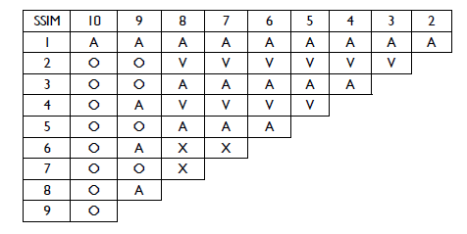
Developing the Structural Self Interaction Matrix (SSIM)
The SSIM was developed by carrying out the pair-wise comparison of elements using the relationship and notations as explained earlier

Slide 17
Developing the Reachability Matrix
Based on the above SSIM, the reachability matrix is drawn as follows, by replacing the contextual relationships with binary digits as per the following rules:
If the (i, j) entry in the SSIM is V, the (i, j) entry in the reachability matrix becomes 1 and the ( j, i) entry becomes O.
If the (i, j) entry in the SSIM is A, the (i, j) entry in the reachability matrix becomes 0 and the ( j, t) entry becomes 1,
If the (i, j) entry in the SSIM is X, the (i, j) entry in the reachability matrix becomes 1 and the ( j, I) entry also becomes 1.
If the (i, j) entry in the SSIM is 0, the (i, j) entry in the reachability matrix becomes 0 and the ( j, i) entry also become 0.

Slide 18
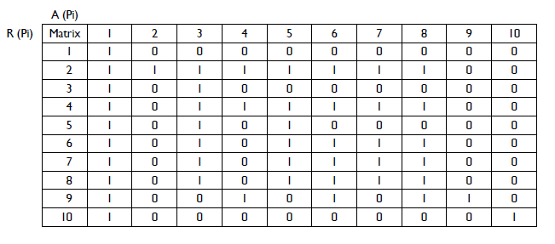
Reachability Matrix

Slide 19
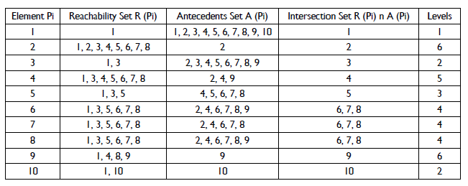
Partitioning

Slide 20
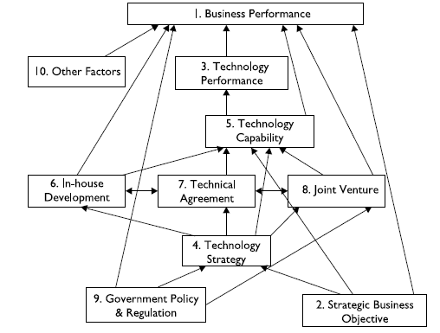
Leveling of Elements and Construction of Diagraph
The various elements are levelled and the diagraph is constructed using the relationship from SSIM

Slide 21
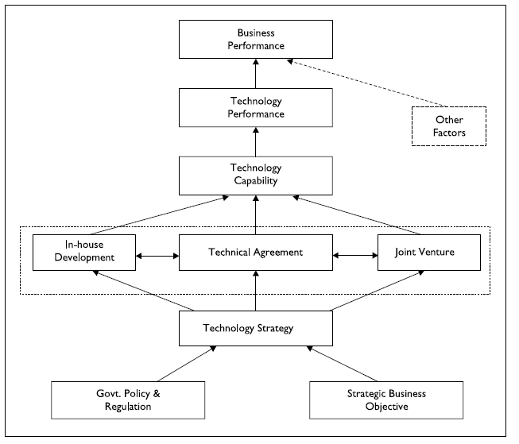
Final Diagraph
By removing the direct links, the final diagraph is made

Slide 22
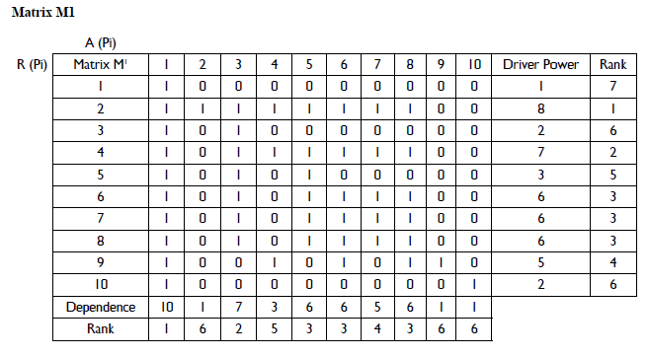
MICMAC Analysis
carried out over initial adjacency matrix M1. The process of matrix multiplication was continued till the time the ranks of factors based on driving power and dependence becomes stabilized (M4).

Slide 23
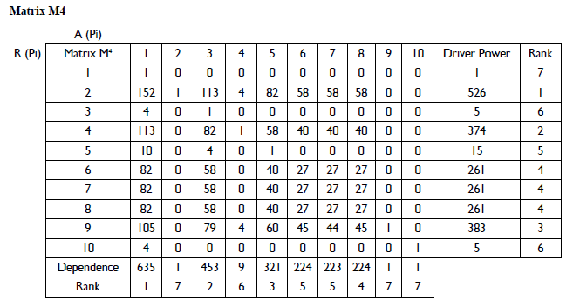
Stable Matrix M4

Slide 24
MICMAC Analysis
Cluster I: Weak driver and weak dependent factors (points near the origin), a group of so-called autonomous factors. These factors are relatively disconnected from the system—they have only a few links, though these links could be very strong.
Cluster II: Weak driver and strong dependent factors. These factors are mainly dependent.
Cluster III: Strong driver and strong dependent factors. These linkage factors should be studied more carefully. Any action on these factors will impact others.
Cluster IV: Strong driver and weak dependent factors. They condition the rest of the system and are called ‘Independent’.

Slide 25
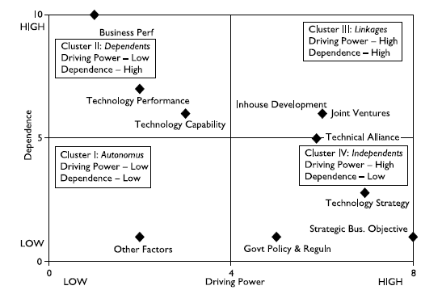
Driving Power and Dependence of Factors for STM (based on M1)

Slide 26
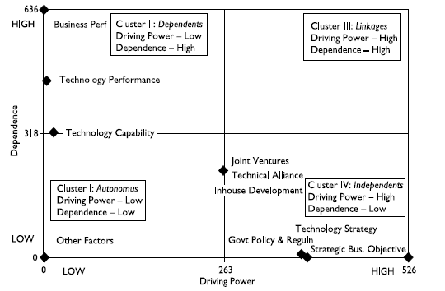
Driving Power and Dependence of Factors for STM (based on M4) after MICMAC

Slide 27
